Slide 1
Deputation Presented by
Carol McDonald, OCSH President
Ottawa Board of Health
November 17, 2014

Slide 2
Why Are We Here?
To congratulate Ottawa Public Health on the success of the 2012 smoke-free outdoor bylaw and to support their report on the implementation of the bylaw.
Tobacco use is still the #1 cause of preventable disease, disability, and premature death in the City of Ottawa.
To address ongoing requests for help from individuals and families who continue to suffer from exposure to second-hand smoke in public places, workplaces, and multi-unit dwellings.
To advocate for more smoke-free public places and workplaces.
Notes:
- Lung cancer is the most common, lethal, complex disease.
- 80% of lung cancers are attributable to tobacco.

Slide 3
Why Are We Here?
To request further action from the Ottawa Board of Health regarding the smoke-free indoor and outdoor bylaws.
Rationale for Ottawa’s smoke-free indoor and outdoor bylaws:
No safe level of exposure to second-hand smoke
All workers deserve equal protection
Protect children
Level playing field for all businesses.
Notes:
- Need to provide the public and workers with additional protection from second-hand smoke.
- More smoke-free spaces will further reduce smoking rates.
- Prevent more youth from starting to smoke, from using unregulated tobacco and nicotine products, and from becoming addicted to nicotine.
- Reduce health care costs.

Slide 4
Requested Amendments
Prohibit the use of electronic cigarettes and waterpipes inside and outside all public places and workplaces:
Add hotels, motels, and B & B establishments to the smoke-free indoor bylaw.
Notes:
- 78% of Ottawa residents support smoke-free hotels, motels and B & B establishments: http://ottawa.ca/en/residents/public-health/healthy-living/smoke-free-spaces-survey-results-0

Slide 5
Requested Amendments
Add these public places and workplaces to the smoke-free outdoor bylaw:
Hospital campuses
Pedestrian malls, shopping concourses, promenades, and public squares (e.g. the Sparks Street Mall; Lansdowne Park, an 18-acre urban park)
Post-secondary campuses
Construction sites
9 meters from doorways to multi-unit buildings and commercial buildings.
Notes:
- Ottawa Public Health Survey (http://ottawa.ca/en/residents/public-health/healthy-living/smoke-free-spaces-survey-results-0:):
-78% support smoke-free hospital campuses
-84% of Ottawa residents support smoke-free doorways

Slide 6
Electronic Cigarettes
20% of youth in Ottawa have reported using e-cigarettes. [1]
Health Canada website: “Electronic cigarette products with nicotine and/or health claims require authorization prior to being imported or sold in Canada. To date, no electronic cigarettes with nicotine and/or health claims have been authorized by Health Canada and their safety, quality, and efficacy remain unknown.” [2]
Notes:
[1] Ottawa Public Health. Ottawa Student Drug Use and Health Report, 2014. http://documents.ottawa.ca/en/node/6000
[2] Government of Canada. Nicotine Addiction. Accessed November 12, 2014. http://healthycanadians.gc.ca/healthy-living-vie-saine/tobacco-tabac/addiction-dependance-eng.php

Slide 7
Electronic Cigarettes
Lack of scientific evidence that vaping helps people to quit smoking. [3], [4], [5]
Scientific evidence about e-cigarette vapor:
Contains nicotine, carcinogens, and heavy metals [6], [7]
Can cause lung irritation [8] and asthma attacks [9]
Non-smokers who are exposed can absorb nicotine. [10]
Notes:
[3] Harrell PT, Simmons Vn, Correa JB et al. Electronic nicotine delivery systems ("e-cigarettes"): review of safety and smoking cessation efficacy. Otolaryngol Head Neck Surg. 2014 Sep;151(3):381-93. doi: 10.1177/0194599814536847. Epub 2014 Jun 4. http://www.ncbi.nlm.nih.gov/pubmed/24898072
[4] Orr KK, Asal NJ. Efficacy of Electronic Cigarettes for Smoking Cessation. Ann Pharmacother. 2014 Nov;48(11):1502-1506. Epub 2014 Aug 18. http://www.ncbi.nlm.nih.gov/pubmed/25136064
[5] Odum LE, O’Dell KA, Schepers JS. Electronic cigarettes: do they have a role in smoking cessation? J Pharm Pract. 2012 Dec;25(6):611-4. doi: 10.1177/0897190012451909. Epub 2012 Jul 13.
http://www.ncbi.nlm.nih.gov/pubmed/22797832
[6] Grana R, Benowitz N, Glantz SA. E-cigarettes – A Scientific Review. Circulation. 2014; 129:1972-1986. http://circ.ahajournals.org/content/129/19/1972.full
[7] U.S. Food and Drug Administration. Summary of Results: Laboratory Analysis of Electronic Cigarettes Conducted by FDA, updated April 22, 2014. http://www.fda.gov/newsevents/publichealthfocus/ucm173146.htm
[8] Health Canada. Health Canada Advises Canadians Not to Use Electronic Cigarettes, Product Safety Advisory, March 27, 2009. http://www.healthycanadians.gc.ca/recall-alert-rappel-avis/hc-sc/2009/13373a-eng.php
[9] American College of Allergy, Asthma, and Immunology. E-cigarettes: Not a healthy alternative to smoking, News Release, May 27, 2014. http://www.eurekalert.org/pub_releases/2014-05/acoa-ena052314.php
[10] Ballbè M, Martínez-Sánchez JM, Sureda X. Cigarettes vs. e-cigarettes: Passive exposure at home measured by means of airborne marker and biomarkers. Environmental Research Volume 135, November 2014, Pages 76–80. http://www.sciencedirect.com/science/article/pii/S0013935114003089

Slide 8
Electronic Cigarettes
Canadian municipalities have passed bylaws (e.g. Toronto, Vancouver). Nova Scotia’s ban comes into effect on May 31, 2015.
U.S. cities have passed laws (e.g. New York, Boston, Los Angeles, Chicago).
Canadian school boards are passing policies because students are using e-cigarettes in classrooms!
The University of Montreal adopted a policy banning the use of e-cigs inside buildings and within 9 meters of doorways.
Notes:
Examples of school boards with e-cig policies: Vancouver; Edmonton; Winnipeg; Brandon, Manitoba
Examples of municipal and provincial laws:
- Toronto (inside municipal work places & requested a provincial ban)
- Red Deer, Alberta (indoor ban)
- Nelson, BC (indoor ban)
- Vancouver, BC (indoor ban)
- Elgin County, Ontario (inside municipal workplaces)
- Montreal (requested a provincial ban)
- Nova Scotia (provincial law in effect)

Slide 9
Electronic Cigarettes
Many health organizations support banning their use in public places and workplaces:
World Health Organization
United Nations Health Agency
Heart and Stroke Foundation
Canadian Cancer Society
Non-Smokers’ Rights Association
American Heart Association.
Ottawa must take action based on current scientific data and the Precautionary Principle. The long-term risks of vaping and exposure to second-hand vapors are unknown.

Slide 10
Waterpipes
11 waterpipe establishments in Ottawa.
No legal barriers to passing an indoor bylaw in Ottawa:
B.C. provincial court ruling upheld Vancouver’s bylaw [11]
Alberta and Quebec have passed provincial laws
Ontario municipalities have passed bylaws. [12]
Scientific study of air quality in waterpipe establishments in Toronto [13]:
Staff and patrons were exposed to “air quality levels considered hazardous to human health.”
“Results support eliminating waterpipe smoking in hospitality venues inside and out.”
Notes:
References:
[11] Tara Carman. Two Vancouver hookah shop owners lose fight to allow smoking; B.C. court upholds city bylaw prohibiting their use in business premises and common areas. Vancouver Sun, August 12, 2014. http://www.vancouversun.com/health/Vancouver+hookah+shop+owners+lose+fight+allow+smoking/10112703/story.html
[12] Non-Smokers’ Rights Association. Municipalities in Canada with Waterpipe Bylaws. January 2014. https://www.nsra-adnf.ca/cms/file/files/Municipalities_with_Waterpipe_Bylaws-FINAL_Jan_15_2014.pdf
[13] Zhang B, Haji F, Kaufman P. Muir S, Ferrence R. "Enter at your own risk": A multimethod study of air quality and biological measures in Canadian waterpipe cafes. Tobacco Control. October 25, 2013. http://www.ncbi.nlm.nih.gov/pubmed/24161999

Slide 11
Sparks Street Mall
The OCSH has received numerous complaints about second-hand smoke along the mall, and about second-hand smoke drifting into workplaces, stores, and health clinics.
The mall hosts cancer fundraisers; blood donor clinics; children’s events; amusement rides; culinary festivals; and live music, dancing, and sporting events. All of these events should occur in a 100% smoke-free environment, similar to events held on city property.
All parks, patios, playgrounds, music, food, and retail venues in Ottawa are 100% smoke-free! Why not Sparks Street Mall?
A smoke-free bylaw would support mall employees and visitors who are trying to quit smoking and to stay smoke-free.

Slide 12
Sparks Street Mall
Everything but a “street”
City of Ottawa’s Official Plan for the Sparks Street Mall:
“Oasis in the heart of the City”
“ensure…a pleasant pedestrian environment...”
25 examples worldwide of smoke-free pedestrian malls, plazas, town squares, outdoor shopping areas, and street fairs
Times Square in New York City is smoke-free!
NYC → 8.4 million residents [14] vs. Ottawa → 870,250 residents [15]
Notes:
[14] New York City Department of Planning. Population. http://www.nyc.gov/html/dcp/html/census/popcur.shtml
[15] City of Ottawa. Population. http://ottawa.ca/en/long-range-financial-plans/economy-and-demographics/population

Slide 13
Source: Sparks Street BIA, Twitter, August 22, 2013 https://twitter.com/SparksStreet/status/370592527990001666/photo/1

Slide 14
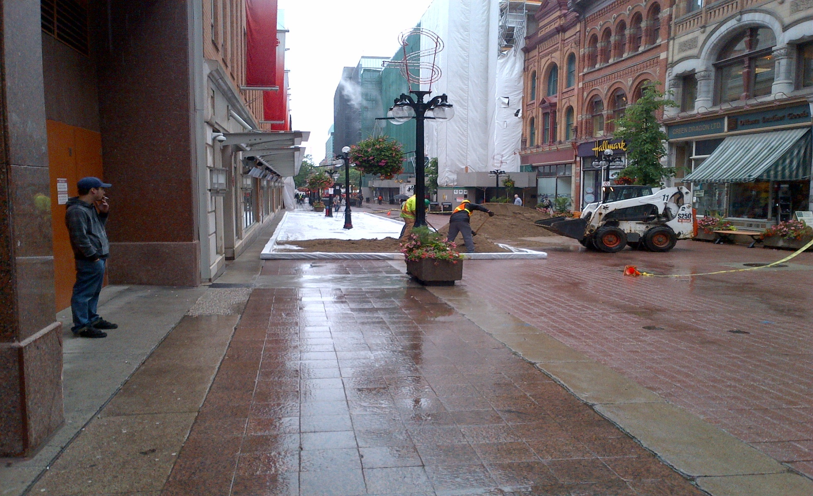
Setting up the “world’s largest sandbox” on the Sparks Street Mall, June 2013

Slide 15
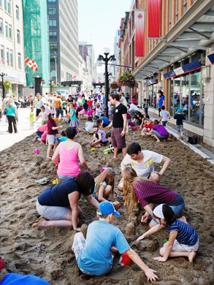
Source: Sparks Street Mall, World’s Largest Sandbox, The Ottawa Citizen, June 12, 2013. www.ottawacitizen.com/news/Photos+Video+World+Largest+Sandbox/8516949/story.html

Slide 16
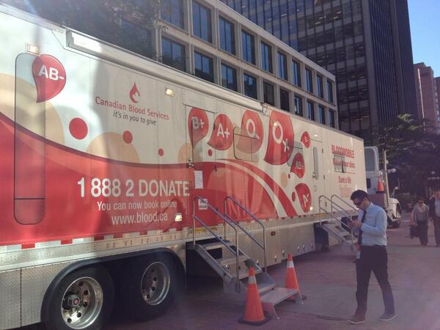
Source: Sparks Street BIA, Twitter, September 26, 2013.
https://twitter.com/SparksStreet/status/383261156489428992/photo/1

Slide 17
Sparks Street Mall
The OCSH asks that the City of Ottawa and the Board of Health resolve this long-standing public health issue by again requesting that the province:
Amend the Ontario Highway Traffic Act such that any part of a roadway that includes a pedestrian mall, plaza, public square, outdoor shopping area, sidewalks, etc…be smoke-free
Amend the Smoke-Free Ontario Act such that municipal smoke-free bylaws apply to pedestrian malls, plazas, public squares, outdoor shopping areas, sidewalks, etc..
The OCSH also asks the City of Ottawa to ensure that all events on the mall are smoke-free.

Slide 18
Hospital Campuses
We are responding to ongoing requests for help about second-hand smoke at hospital entranceways.
Patients and hospital staff who smoke on hospital property off-gas third-hand smoke → a health risk to patients, staff, and visitors.
Ottawa Public Health Survey: 78% of Ottawa residents support smoke-free hospital campuses. [16]
Questions for the Ottawa Board of Health:
Why are vulnerable patients, hospital staff, and visitors still exposed to second-hand smoke at health care facilities?
Why are hospital staff modeling nicotine addiction to patients on hospital property?
Notes:
[16] Ottawa Public Health. Smoke-free spaces survey results. 2011.
http://ottawa.ca/en/residents/public-health/healthy-living/smoke-free-spaces-survey-results-0
Other hospitals in Ontario have adopted 100% smoke free campuses by successfully addressing unique challenges on their campuses. Why can’t patients, visitors, and hospital staff in Ottawa have the same level of protection?

Slide 19
Hospital Campuses
10 jurisdictions in Ontario have passed bylaws prohibiting smoking on hospital campuses. [17]
Examples of 100% Smoke-Free Hospital Campuses:
Centre for Addiction and Mental Health (Toronto)
11 hospital properties in Grey-Bruce (Ontario)
North Bay Regional Health Centre
Sault Area Hospital (Sault Ste. Marie)
St. Michael’s Hospital (Toronto)
Sunnybrook Hospital (Toronto)
Thunder Bay Regional Health Science Centre
New York-Presbyterian/Weill Cornell Medical Center
Notes:
[17] Non-Smokers’ Rights Association. Smoke-Free Laws Database. Accessed November 12, 2014. http://www.nsra-adnf.ca/cms/index.cfm?group_id=2198

Slide 20
Hospital Campuses
If a hospital in New York City can do it, why can’t hospitals in the City of Ottawa?
New York City → 8.4 million residents [18] vs. City of Ottawa → 870,250 residents [19]
CHEO has expressed support to the OCSH for a smoke-free campus!
Notes:
[18] New York City Department of Planning. Population. http://www.nyc.gov/html/dcp/html/census/popcur.shtml
[19] City of Ottawa. Population. http://ottawa.ca/en/long-range-financial-plans/economy-and-demographics/population

Slide 21
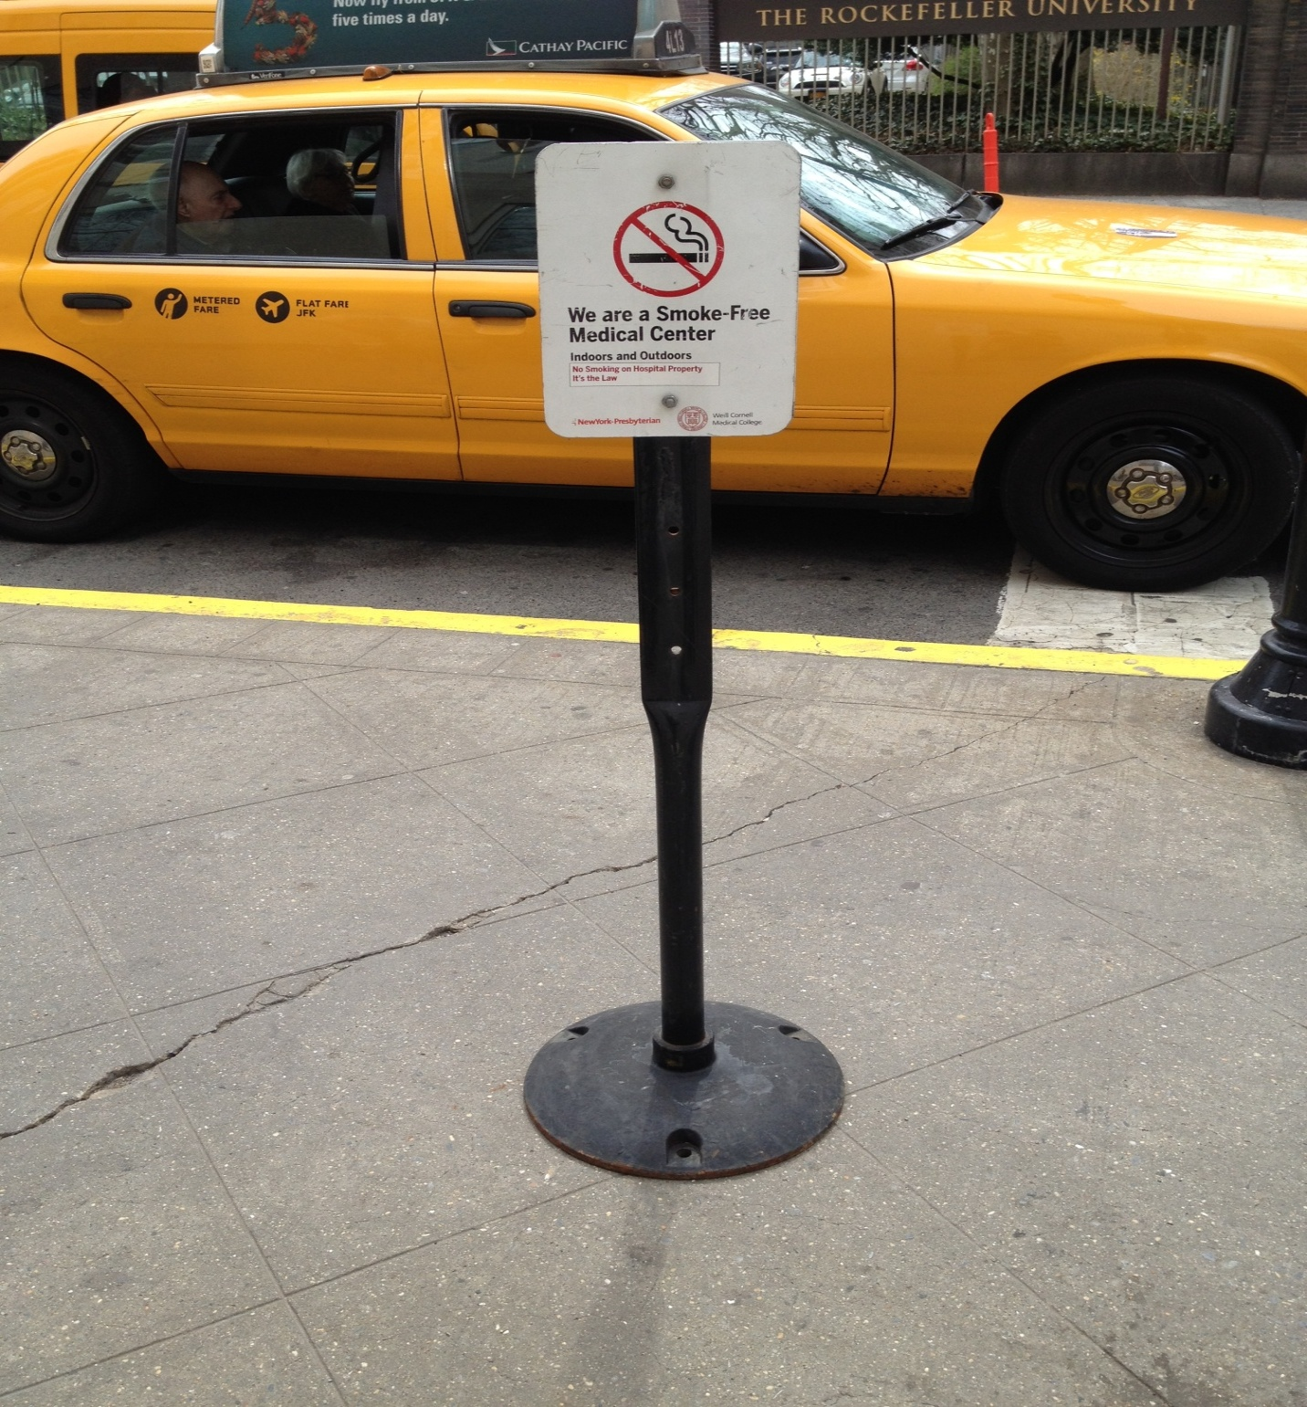
New York-Presbyterian Hospital/Weill Cornell Medical Center
New York City, August 2013
Notes:
- Photo of a smoke-free sign near an iconic yellow taxi in New York City.

Slide 22
Next Steps
The OCSH is concerned about the slow political and legal process:
Ottawa Public Health’s report is for information purposes only. It does not recommend any new bylaws.
The length of time before the new Board of Health will recommend additional protection for Ottawa residents.
Lack of legal process to review smoke-free bylaws on a regular basis to address emerging issues.
Continue to be leaders in Ontario.

Slide 23
Next Steps
The OCSH congratulates Ottawa Public Health and the Board of Health for their leadership in tobacco control.
The OCSH looks forward to the next steps in tobacco control. We will continue to advocate for smoke-free regulations to:
Prevent our youth from becoming addicted to unregulated tobacco and nicotine products (e.g. waterpipes, electronic cigarettes).
Help Ottawa residents who are dying prematurely from continued exposure to second-hand smoke and from tobacco and nicotine addiction.
Scientific evidence proves that smoke-free spaces help smokers to quit smoking. [20], [21]
Notes:
[20] Chaiton M, Diemert L, Zhang B. Exposure to smoking on patios and quitting: a population representative longitudinal cohort study. Tob Control. 2014 Oct 28. http://www.ncbi.nlm.nih.gov/pubmed/25352563
[21] International Agency for Research on Cancer. Evaluating the effectiveness of smoke-free policies. Handbooks of cancer prevention, tobacco control, vol. 13. Lyon, France: IARC, 2009.
http://www.iarc.fr/en/publications/pdfs-online/prev/handbook13/handbook13.pdf

